Slide 1
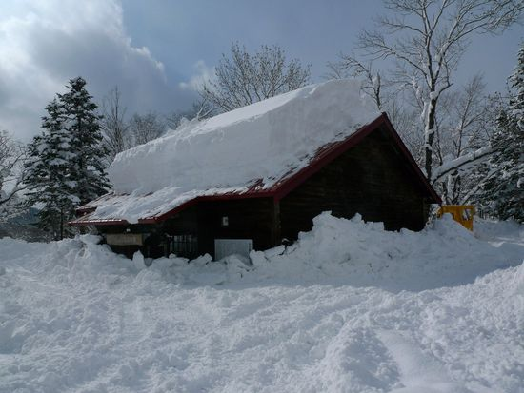
The Usage of Snowfall’s Data
Before I talk about tornadoes, I want to talk about snowfall. Because each phenomenon is relation to atmospheric stability.

Slide 2
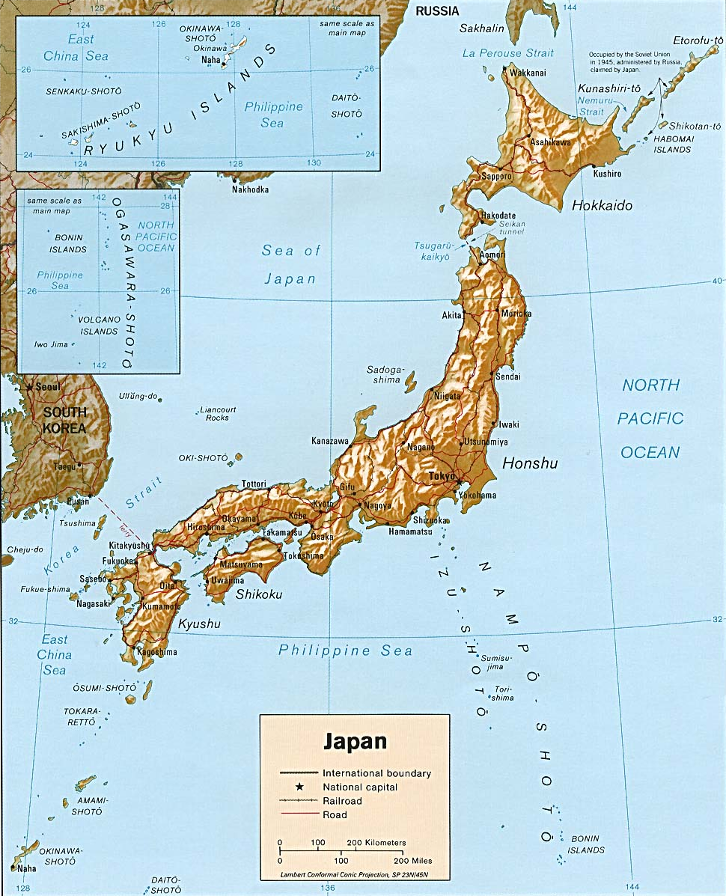
The Japanese Archipelago
This is the shape of the Japanese Islands.
Niigata Prefecture is situated on the Sea of Japan coast.

Slide 3
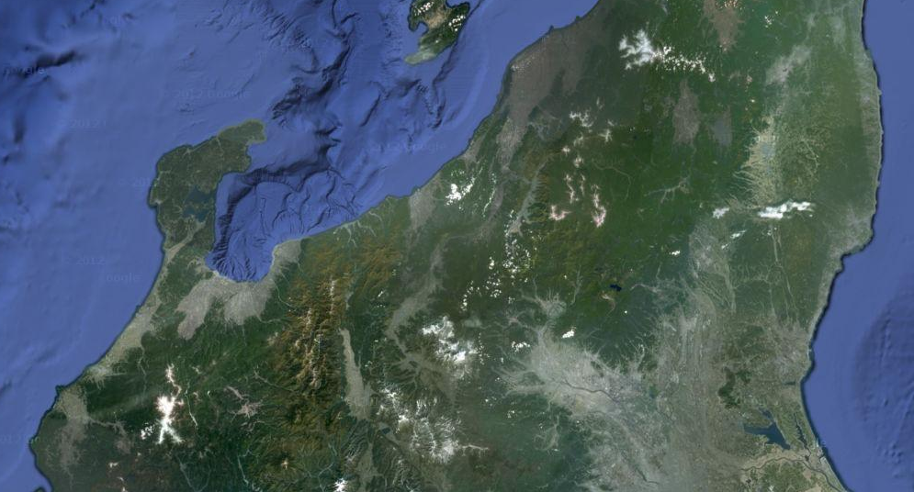
Ｎｉｉｇａｔａ Pｒｅｆｅｃｔｕｒｅ
Ｉｒｉｈｉｒｏｓｅ
Irihirose is a mountain village in Niigata Prefecture.
In this village, there is a lot of snowfall.

Slide 4
Ｎｉｉｇａｔａ Pｒｅｆｅｃｔｕｒｅ
I will explain about the temperature of a 500hPa isopiestic surface later, this is data from Wajima.
Wajima
Ｉｒｉｈｉｒｏｓｅ

Slide 5
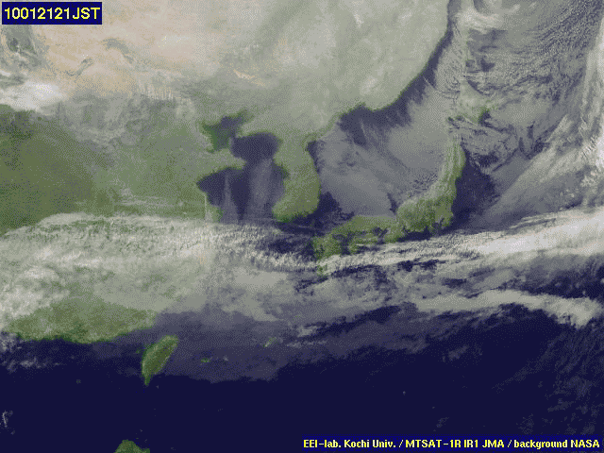
This is the line-formed cloud
which occurs in the Sea of Japan
Tsushima warm current flows
The Sea of Japan is warm even in winter. This is because of the
Tsushima warm current flows.
In contrast, a seasonal wind in winter from the Eurasian Continent is very cold. The steam which evaporates from the Sea of Japan condenses, and it snows.

Slide 6
What are the elements of an atmospheric stability？
If atmospheric stability of the sky is not good, a lot of snow will fall.
There are some factors that affect atmospheric stability. Especially, we want to focus on two factors today.
The first is, …
the temperature of the cold air
The second is, …
humidity
We can get these data from the homepage of the
Japan Meteorological Agency.

Slide 7
What are the elements of atmospheric stability？
Cold air
This mass of air
continue to rise.
This mass of air
doesn’t rise.
Rise
Doesn’t Rise
Because it is
lighter than
the air of the
circumference,…
Because it is
heavier than
the air of the
circumference,…
Rise
Rise
Mass of air
Mass of air
Instability
Stability
The water vapor in the air becomes saturated and condensation begins. If there is much water vapor, much rain or snow falls.
Much water vapor means that the rate of humidity is high.

Slide 8
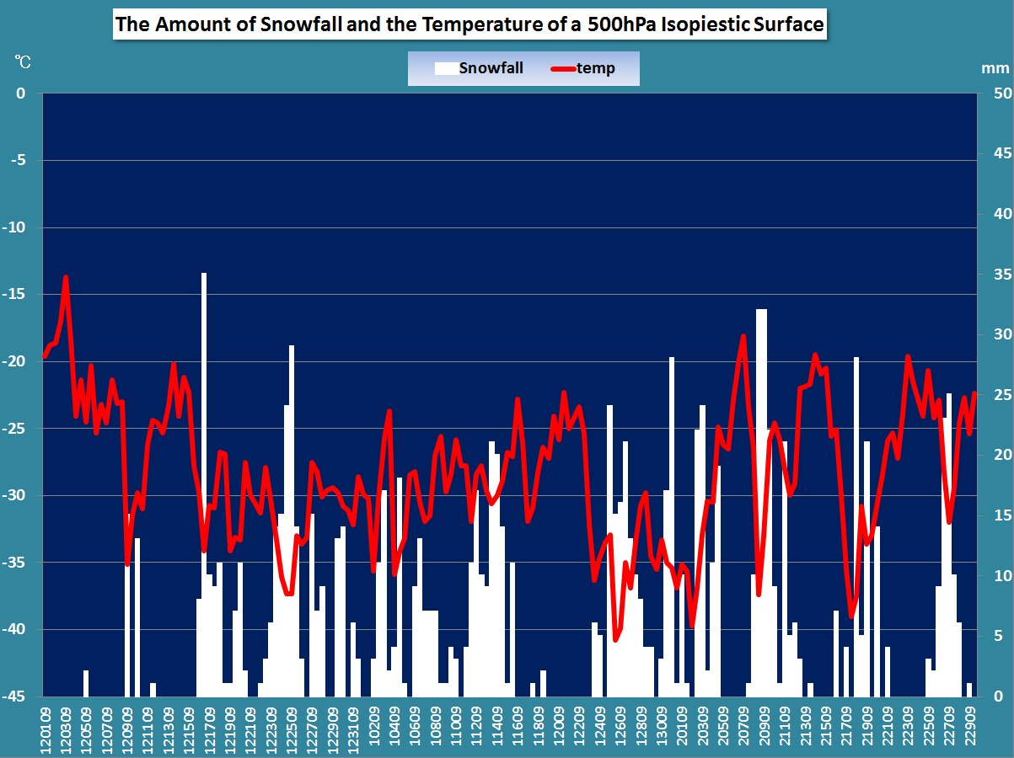
This graph shows the relationship between the temperature of a 500hPa isopiestic surface and the snowfall at Irihirose. This graph
shows the period from December, 2011 to February, 2012.
The height of a 500hPa isopiestic surface is about 5500m.

Slide 9
If the temperature is lower than -30 degrees,
there is a tendency for much snow to fall.

Slide 10
From this time,
I use the word “Upper air”
instead of “500hPa isopiestic surface”.
The height of the upper air is
about 5500m.
Similarly,
I use the word “Lower air”
instead of “850hPa isopiestic surface”.
The height of the lower air is
about 1500m.

Slide 11
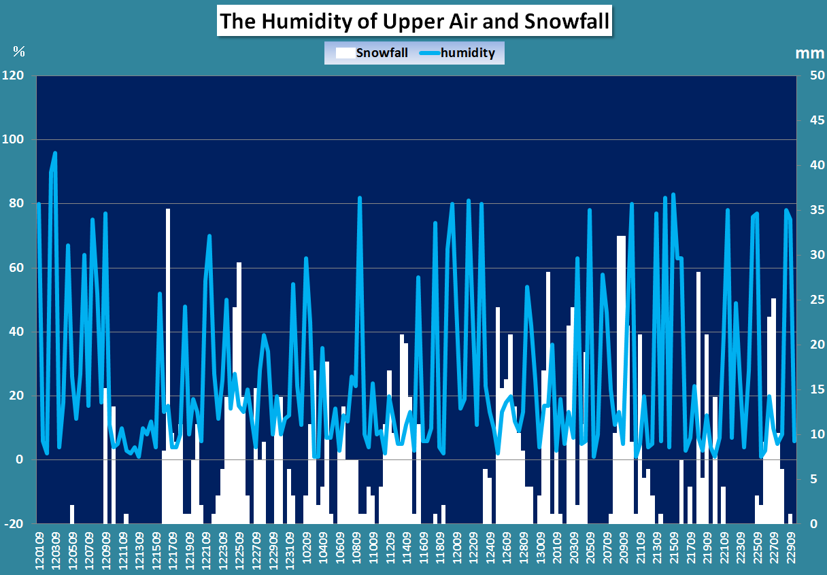
This graph shows the relationship between the humidity of upper air and snowfall.

Slide 12
Because the shape of this line graph is complicated, it is difficult for us to understand whether there is some relationship between these two elements. I want to draw a scatter diagram later.

Slide 13
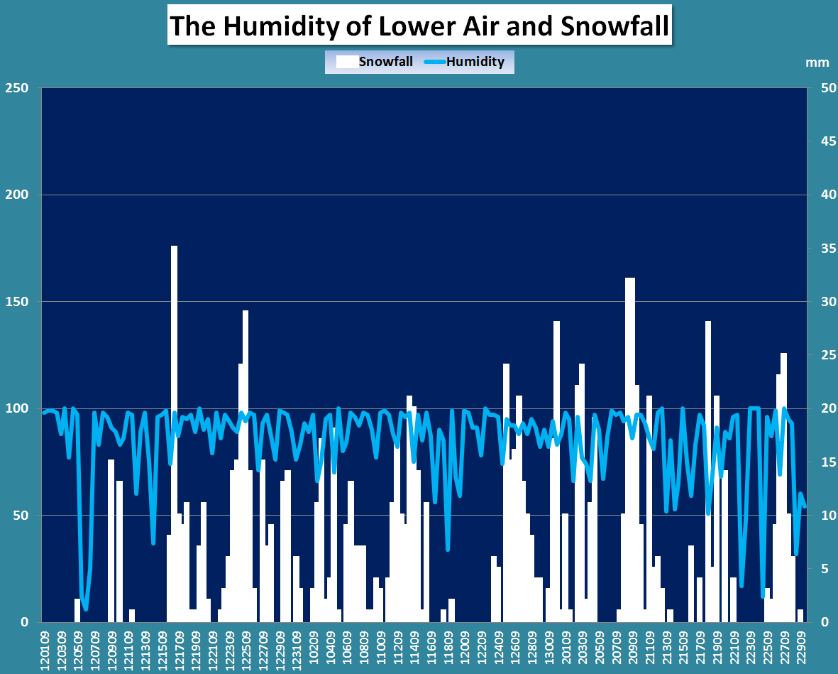
％
This is a graph that shows the relationship between the humidity of lower air and snowfall. Because the shape of this line graph is complicated, I want to draw a scatter diagram later.

Slide 14
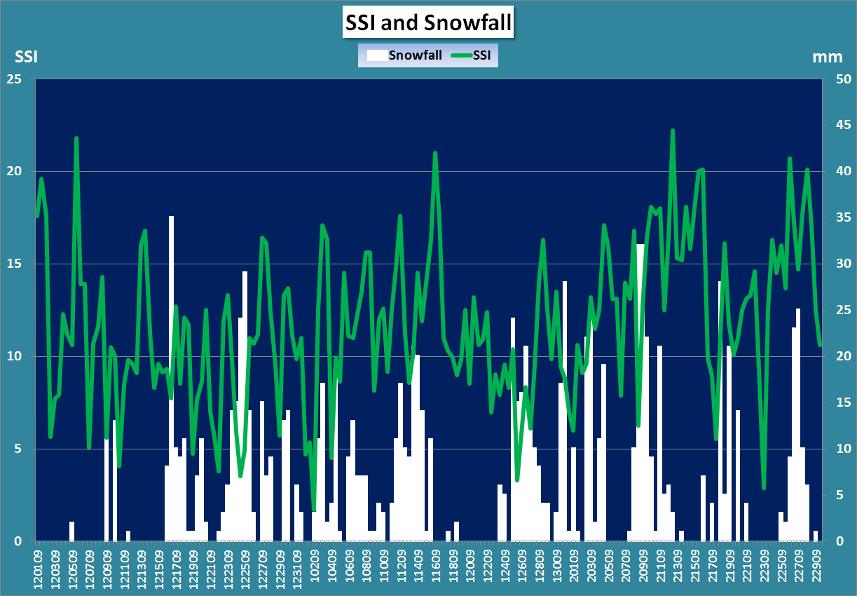
SSI is the notation “Showalter Stability Index” . The value of SSI measured atmospheric stability. Though the calculation method of SSI is difficult, the value is related to the temperature of cold air and humidity. If the value of temperature is low, the atmospheric stability is not good. And if the ratio of the humidity is high, the atmospheric stability is not good either. I could get the values of the SSI from the homepage of Wyoming University.
If the temperature is lower than -30 degrees, there is a tendency of much snowfall. As a cold air flows into the sky, an atmospheric condition becomes unstable.

Slide 15
Generally speaking, if the value of the SSI is low, there is a tendency for much snow to fall.

Slide 16
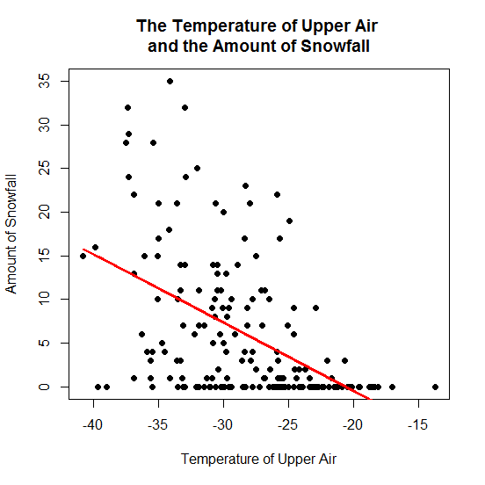
This scatter diagram expresses the relationship between the temperature of upper air and the amount of snowfall.
If we see this scatter diagram,
we may think that there is a negative correlation.
According to the t-test of the correlation coefficient, we can confirm that there is a negative correlation.
The value of the correlation coefficient is approximately
-0.50. This is not weak enough to indicate a negative correlation I think.
If the temperature of upper air is low, much snow falls.

Slide 17
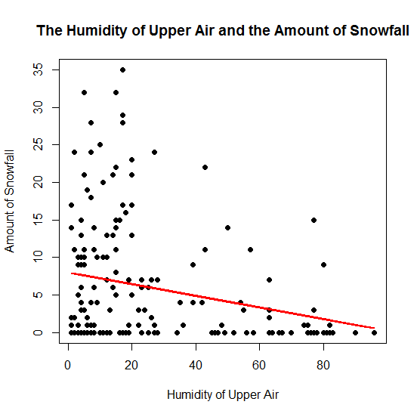
This scatter diagram expresses the relationship between the humidity of upper air and the amount of snowfall.
If we see this scatter diagram,
we may think that there is a weak negative correlation.
According to the t-test of the correlation coefficient, we can confirm that there is a negative correlation.
The value of the correlation coefficient is approximately
-0.24. This absolute measure is not so large I think. But if upper air is dry, much snow falls.

Slide 18
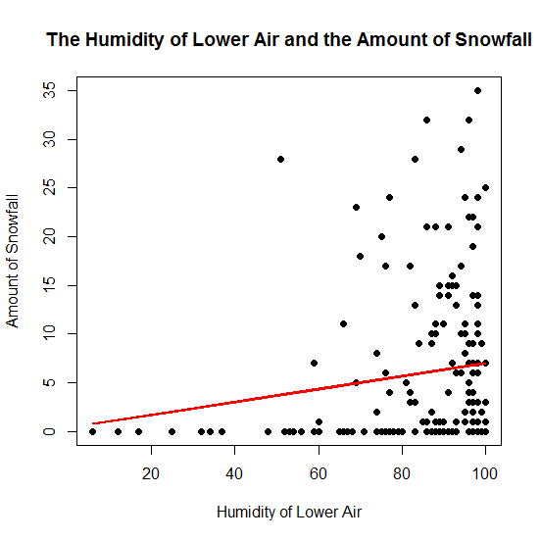
This scatter diagram expresses the relationship between the humidity and the amount of snowfall.
If we see this scatter diagram, we may think that there is a weak positive correlation. According to the t-test of the correlation coefficient, we can confirm that there is a positive correlation. The value of the correlation coefficient is approximately -0.24. This absolute measure is not so large I think. But if lower air is wet, much snow falls.

Slide 19
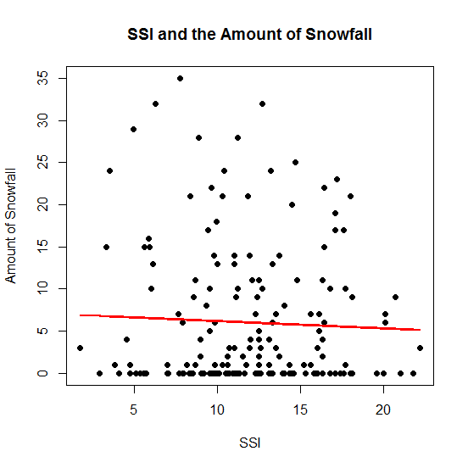
This scatter diagram expresses the relationship between SSI and the amount of snowfall.
As the result of the t-test of correlation coefficient, there was unexpectedly not a significant correlation between the values of SSI and the amount of snowfall.
The value of the correlation coefficient is approximately -0.044.

Slide 20
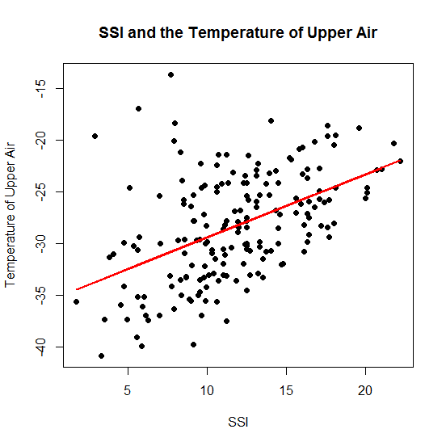
This scatter diagram expresses the relationship between SSI and the temperature of upper air.
As the result of the t-test of the correlation coefficient, there is a significant correlation between the values of the SSI and the temperature of upper air though there was not a correlation between the SSI and the amount of snowfall.
The value of the correlation coefficient is approximately 0.48.

Slide 21
As a result of these considerations, a prediction of much snow is possible to some extent.
＜Methods of prediction＞
● The temperature of the upper air is lower than
approximately -30 degrees.
● Upper air (the height is about 5500m) is dry.
● Lower air (the height is about 1500m) is wet.
※ Though there was no correlation between
the values of the SSI and the amount of snowfall,
there is a significant correlation between the SSI
and the temperature of upper air.

Slide 22
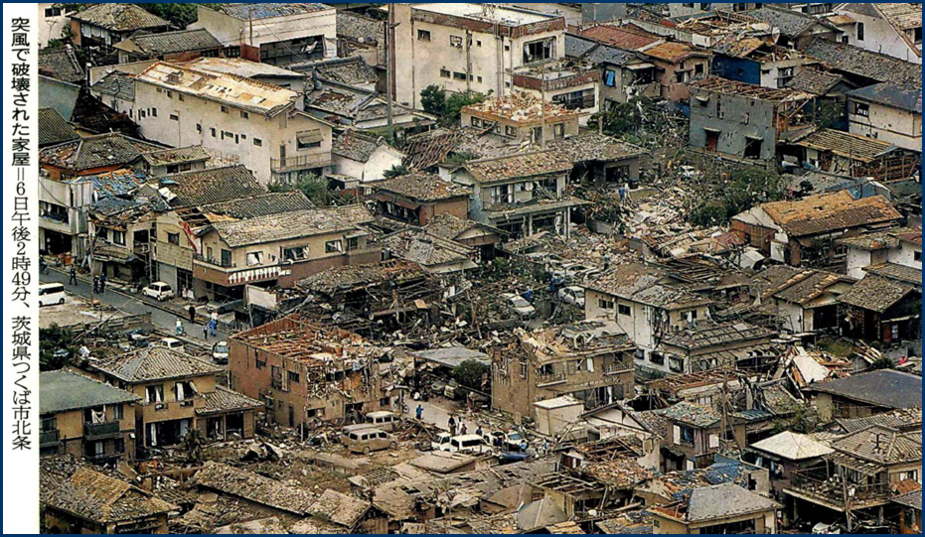
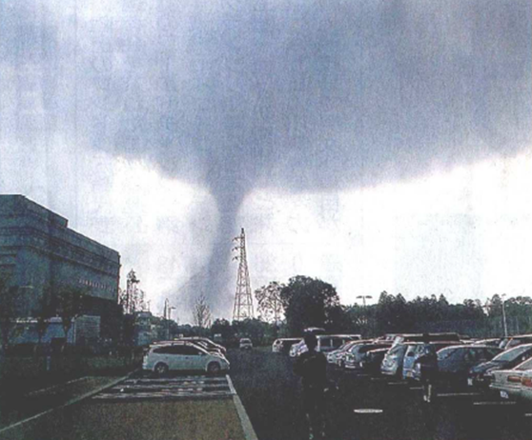
Tornadoes
I will use the data from the upper air again. The data is from Tateno in Ibaraki Prefecture.
Tateno is situated near Tsukuba University.
The case of a tornado in Tsukuba.

Slide 23
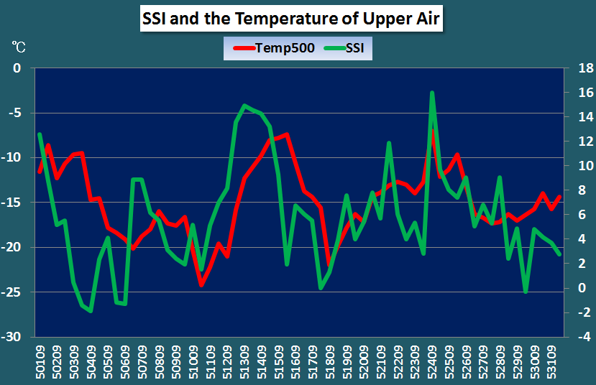
This is a scatter diagram about SSI and the temperature of upper air.
If we see the shape of these line graphs, there may be a positive correlation between the values of SSI and the temperature of upper air.

Slide 24
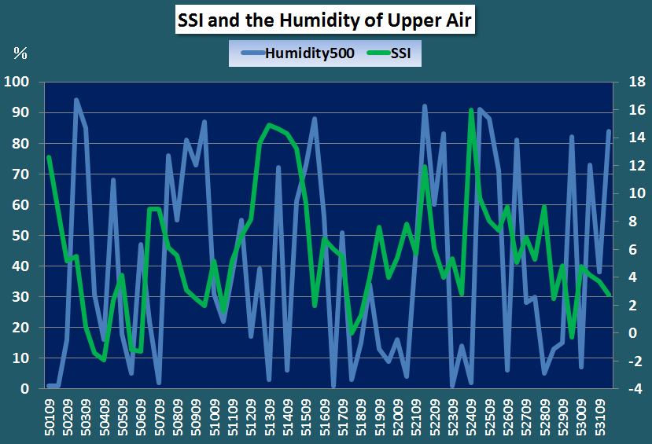
This is a scatter diagram about SSI and the humidity of upper air.
Because the shape of the line graph is complicated, it is difficult to judge whether there is a correlation.

Slide 25
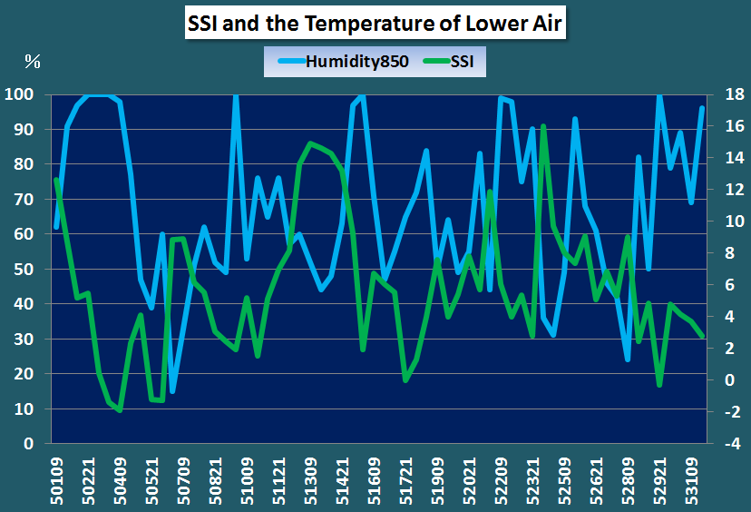
This is a scatter diagram about SSI and the temperature of lower air.
Though the shape of the line graph is complicated,
there may be a negative correlation.

Slide 26
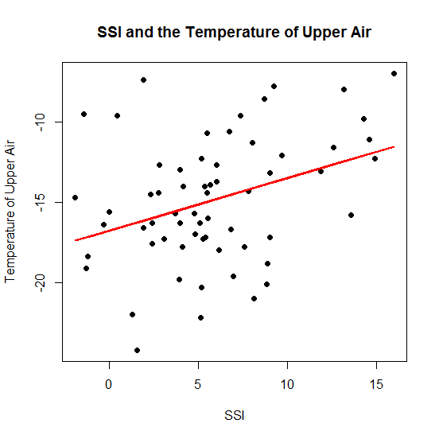
This scatter diagram expresses the relationship between SSI and the temperature of upper air.
As the result of the t-test of the correlation coefficient, there is a significant correlation between the values of the SSI and the temperature of upper air . The value of the correlation coefficient is approximately 0.35.
A tornado occurred.

Slide 27
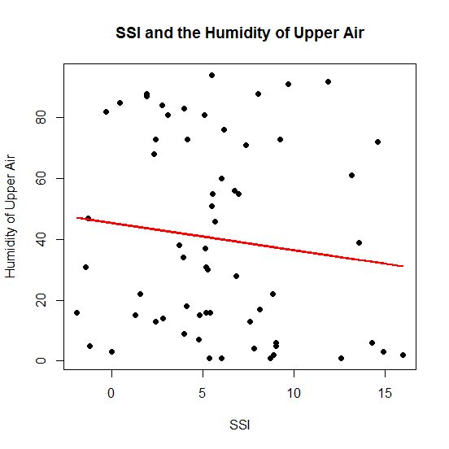
This scatter diagram expresses the relationship between SSI and the humidity of upper air.
The tornado occurred.
As the result of the t-test of the correlation coefficient, there is not a significant correlation between the values of the SSI and the humidity of upper air .
The value of the correlation coefficient is approximately
-0.12.

Slide 28
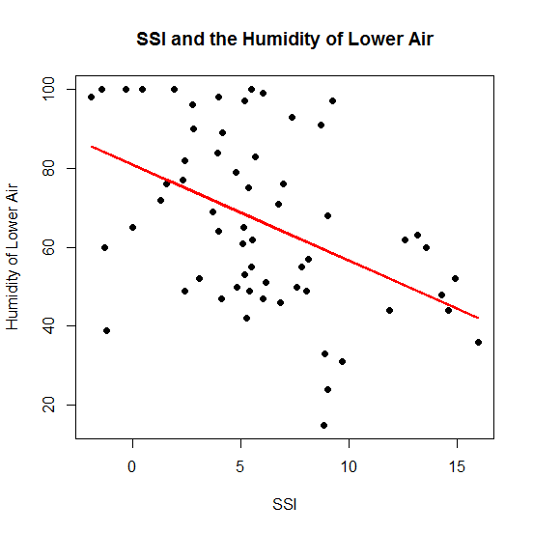
This scatter diagram expresses the relationship between SSI and the temperature of lower air.
As the result of the t-test of the correlation coefficient, there is a significant correlation between the values of the SSI and the temperature of lower air.
The value of the correlation coefficient is approximately
-0.46.
The tornado occurred.

Slide 29
As a result of these considerations, a prediction of a tornado is a little difficult. But, …
＜Methods of prediction＞
● A tornado is easy to be generated so that a value of
the SSI is small.
● Lower air (the height is about 1500m) is wet.
※ When a tornado occurs, we can predict that the
SSI's value was low. But when the SSI's value is low,
it is difficult to predict whether a tornado will occur.

